Slide 1
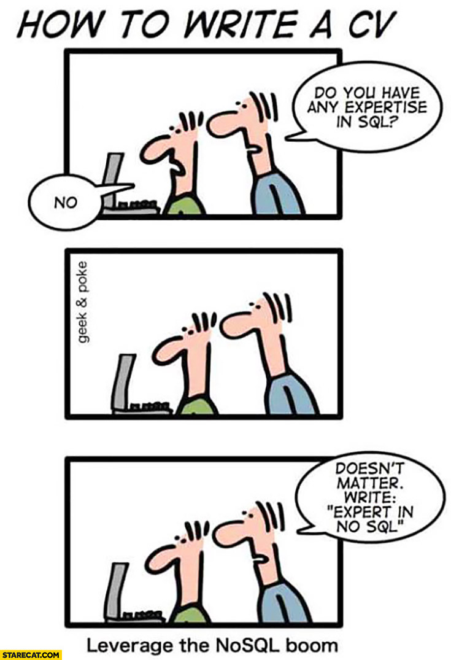
Introduction to NoSQL
CREDITS: Yu-SAN LIN at Penn STate

Slide 2
What is NoSQL?
NoSQL stands for Not Only SQL
Non-­relational database management system
Designed for distributed data stores where very large scale of data storage is needed
may not require a fixed schema
avoids join operations
scales horizontally

Slide 3
Why NoSQL?
NoSQL data modeling often starts from the application-­specific queries
Relational modeling: “What answers do I have?”
NoSQL data modeling: “What questions do I have?”
NoSQL data modeling often requires a deeper understanding of data structures and algorithms than relational database modeling does
NoSQL solutions are surprisingly strong for hierarchical or graph-­like data modeling and processing.

Slide 4
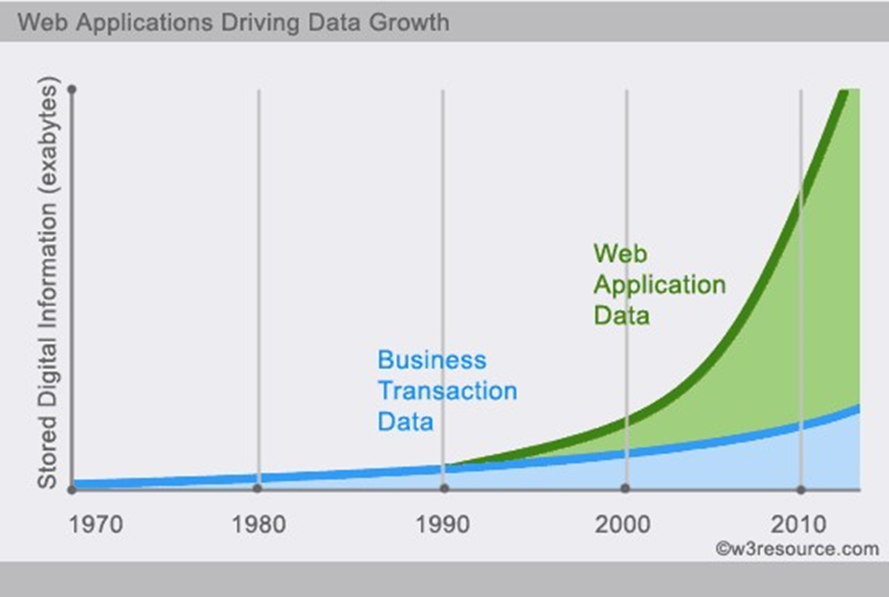

Slide 5
ACID
Atomicity: A transaction is an atomic unit of processing; it is either performed in its entirety or not performed at all.
Consistency preservation: A correct execution of the transaction must take the database from one consistent state to another.
Isolation: A transaction should not make its updates visible to other transactions until it is committed; this property, when enforced strictly, solves the temporary update problem and makes cascading rollbacks of transactions unnecessary
Durability or permanency: Once a transaction changes the database and the changes are committed, these changes must never be lost because of subsequent failure.
* from Elmasri textbook

Slide 6
BASE
Basically Available: This constraint states that the system does guarantee the availability of the data; there will be a response to any request. But, that response could still be ‘failure’ to obtain the requested data or the data may be in an inconsistent or changing state, much like waiting for a check to clear in your bank account.
Soft state: The state of the system could change over time, so even during times without input there may be changes going on due to ‘eventual consistency,’ thus the state of the system is always ‘soft.’
Eventual consistency: The system will eventually become consistent once it stops receiving input. The data will propagate to everywhere it should sooner or later, but the system will continue to receive input and is not checking the consistency of every transaction before it moves onto the next one.
* http://www.dataversity.net/acid-vs-base-the-shifting-ph-of-database-transaction-processing/

Slide 7
Relational vs. NoSQL
Structured and organized data
Structured query language (SQL)
Data and its relationships are stored in separate tables.
Data Manipulation Language, Data Definition Language
ACID transaction properties
No declarative query language
No predefined schema
Key-­Value Pair Store, Column Store, Document Store, Graph databases
Eventual consistency (BASE)
Unstructured and unpredictable data
Prioritizes high performance, high availability and scalability

Slide 8
CAP Theorem
Consistency: Data in the database remains consistent after the execution of an operation, e.g., after an update operation, all clients see the same data
Availability: System is always up; no downtime
Partition Tolerance: System continues to function even if the communication between the distributed servers is unreliable
CAP Theorem says no distributed system can provide all 3

Slide 9
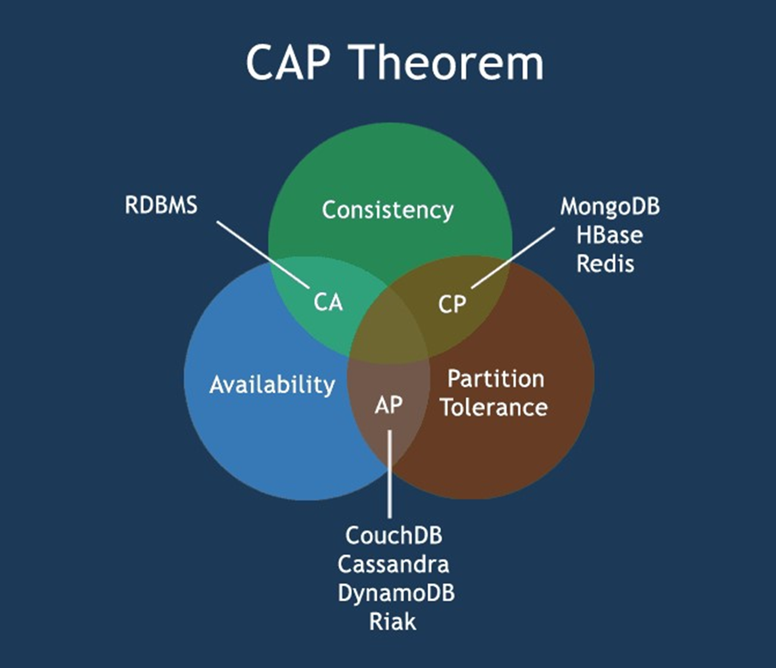

Slide 10
Pros and cons of NoSQL
High scalability
Distributed computing
Lower cost
Schema flexibility, semi-structured data
No complicated relationships
Limited query capabilities (so far)
No transactions
Large number of types and vendors

Slide 11
Types of NoSQL Databases
Key-value pair
Column
Document
Graph

Slide 12
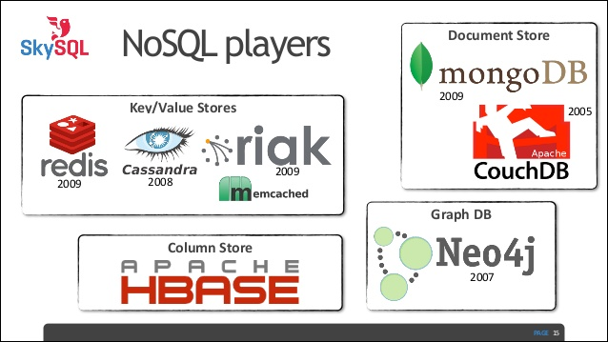

Slide 13
Key-Value Pair Databases
Most basic type of NoSQL database
Designed to handle a huge amount of data: “Big Data”
Each key is unique, value can be any type of data
Suitable for: shopping cart contents, settings

Slide 14
Column Databases
Works on columns
Values of a column are stored contiguously in column-specific files
All data in each data file are the same type, so ideal for compression
High performance on aggregation queries
Suitable for: customer relationship management (CRM), library card catalogs

Slide 15
Graph Databases
Stores data in a graph
Elegantly represents data in a highly accessible way
A collection of nodes and edges
Each node and each edge have unique identifiers

Slide 16
Document Databases
Collection of documents
Data is stored inside documents
A document is a key-value collection
Documents do not typically have a schema, so they are flexible and easy to change
Documents can contain key-value pairs, arrays of pairs or nested documents

Slide 17
